Slide 1
Probability and Statistics

Slide 2
Introduction to Probability and Statistics
Probability and probability distributions,
Hypothesis testing and confidence intervals,
Parametric Tests
Single/Multivariate data analysis techniques,
Pearson Correlation, Z-Test, t-Test, ANOVA
Non-parametric tests
Spearman’s correlation,
Chi-squared, Mann-Whitney, Kruskal-Wallis Tests.
Linear regression

Slide 3
Probability: And rule.
3 tosses of same coin
1 | 2 | 3
T | T | T
T | T | H
T | H | T
T | H | H
H | T | T
H | T | H
H | H | T
H | H | H
P(A → B) = P(A) * P(B)
Fair-Coin toss:
P(3 consecutive heads). ➔ P(h) * P(h) * P(h)
(1/2) * (1/2) * (1/2) = 1/8 = 0.125 = 12.5%
P(H T T) ➔ (1/2) * (1/2) * (1/2) = 1/8
P(2 T and 1 H) ➔ P(H, T, T) + P(T, H, T) + P(T T H) = 3/8
Bag contains 4 red balls, 10 blue balls. We pick 2 balls (no replacement).
R -> B -> R -> B : (4/14) * ( 10/13) * (3/12) * (9/11)

Slide 4
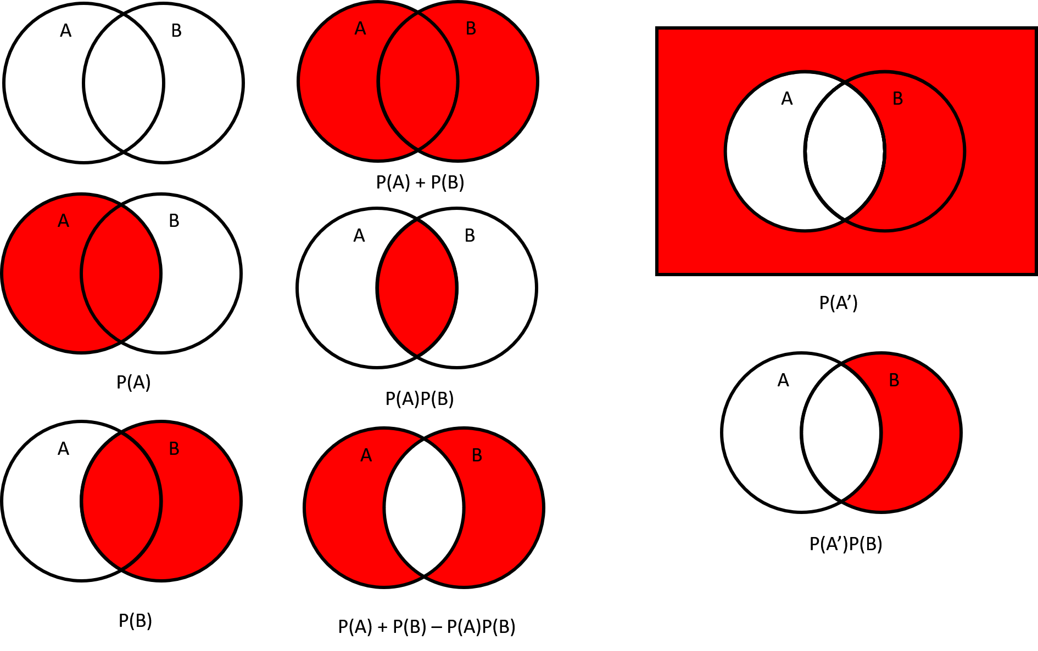

Slide 5
Or Rule: P(A or B) = P(A) + P(B) – P(A&B)
Mutually exclusive events (dependent)
P(train) = .30 P(taxi) = 0.4 P(taxi and train) = 0
P(train or taxi) = P(train) + P(taxi) – P(train and taxi)
= P(train) + P(taxi) = 0.7
Non-mutually exclusive events (independent)
P(chai) = 0.50 P(sandwich) = 0.40
P(Chai & SW) = P(Chai) * P(SW) = 0.5 * 0.4 = 0.20
P(Chai or SW) = P(Chai) + P(SW) – P(Chai & SW)
= 0.5 + 0.4 – 0.2 = 0.7
train
taxi
chai
SW

Slide 6
Practice Questions
Tickets numbered 1 to 20 are mixed up and then a ticket is drawn at random. What is the probability that the ticket drawn has a number which is a multiple of 3 or 5?
A. 1/2
B. 2/5
C. 8/15
D. 9/20
Multiple of 3 = 3, 6, 9, 12, 15, 18 == P(*3) = 6 / 20
Multiple of 5 = 5, 10, 15, 20 == P(*5) = 4 / 20
P(*3) and P(*5) = P(*3 and *5) = 1/20
P(*3) OR P(*5) = P(*3) + P(*5) – P(*3 and *5) = 6/20 + 4/20 - 1/20 ➔ 9/20

Slide 7
Three unbiased coins are tossed. What is the probability of getting at most two heads?
A. 3/4
B. 1/4
C. 3/8
D. 7/8
P(0H, 3T) + P(H, 2T) + P(2H, 1T) = 1/8 + 3/8 + 3/8 = 7/8

Slide 8
Example 3:
/4
/6
One integer is chosen from 1, 2, 3, … 100. What is the probability that it is neither divisible by 4 nor divisible by 6?
Answer: From numbers 1-100,
Numbers divisible by 4 = 25.
Numbers divisible by 6 = 16.
Numbers divisible by 12 (LCM of 4 and 6) = 8.
P(A or B) = P(A) + P(B) – P(A&B)
Also, Numbers divisible by 4 or 6 = 25 + 16 – 8 = 33. Hence, numbers which are not divisible by 4 or 6 = 100 - 33 = 67
Therefore the probability that the number chosen, is neither divisible by 4 nor divisible by 6 = 67/100 = 0.67

Slide 9
Example 4: Multiple Independent events
P( rain ) = 0.5
P(vehicle) = 0.4 P(walk) = 0.6
P(umbrella) = 0.6
P(rains and umbrella) = P(rain)*P(umbrella) = 0.3
P(not rain and vehicle) = [1- 0.5] * 0.4 = 0.20

Slide 10
Bayes Theorem

Slide 11
What is prob of A if B has already happened?
Question to answer is: What proportion of A lies in B?
P(A|B) . P(B) = P(B|A) . P(A)
P(rain) = 0.3 P(sunny) = 0.7 P(Sunny | Rained) = 0.4
What is probability that if it was sunny today, then it will rain tomorrow ?
P(Rain | Sun) = P(Sun | Rain) . P(Rain) / P(Sun)
= 0.4 * 0.3 / 0.7 == 0.17

Slide 12
Distribution Functions
PDF, CDF, PMF

Slide 13
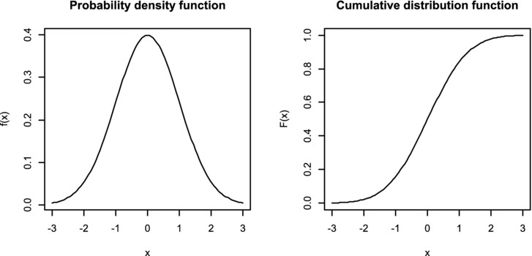
Continuous Variable – PDF and CDF

Slide 14
PDF (probability density function)
For continuous variables only. It describes the likelihood of a random variable taking on a particular value.
The area under a PDF equals 1.
CDF: In addition, a CDF can be expressed as an integral of the PDF in the continuous case.

Slide 15
Discrete (categorical variables)
Continuous
PDF
CDF
Discrete
PMF
A = 0.3 B = 0.2 C = 0.3 D = 0.2

Slide 16
Probability Distribution

Slide 17
Types of Distributions
Uniform
Bernoullis → Binomial
Normal
Poisson’s
Exponential
. . . . And many more.

Slide 18
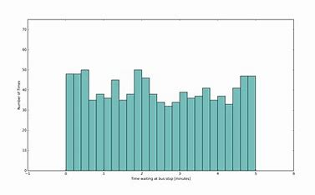
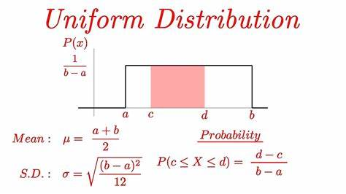
Uniform
If a variable can take a value between 0 to 100.
All possible values have an equal probability of occurring.

Slide 19
Bernoulli’s Distribution
The Bernoulli distribution represents the success or failure of a single Bernoulli trial.
A Trial result in 0 / 1 outcome.
Success or 1 = “event” (P = p)
Failure or 0 = “non event” (Q = 1 – p)
3 Types of Bernoulli’s Distribution
Binomial
Geometric
Pascal’s

Slide 20

Bernoulli: Binomial Distribution
If each Trial in INDEPENDENT: (same probability):
The Binomial Distribution represents the number of successes and failures in n independent Bernoulli trials for some given value of n. ...
Example:: number of heads obtained in tossing a coin n times.
Prob. p and 1-p for Succ/Fail.
Var(X) = p.(1-p) = p.q
Var(S) = n.Var(X) = npq
If npq > 10, then the binomial distribution is a good approximation of the normal distribution.
P( x successes, n trials, p prob ) P(X= x) = ^{n}C_{x} . p^{x} . q^{n-x}
10C₃ . (1/3) ³ . (1 – 1/3) ⁽¹⁰⁻³⁾
.. . . . .
Roll dice. Success => Get 1 or 2
N trials = 10
X successes = 3
P(1 or 2) = 2/6 = 1/3
F
F
S
F
F
F
S
S
F
F

Slide 21
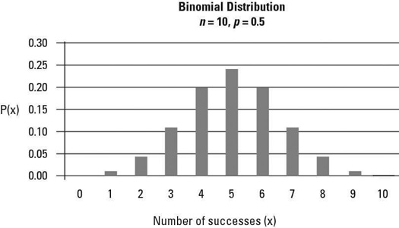
Binomial Distribution

Slide 22
Bernoulli: Geometric Distribution
P(X <= x)
= 1 – q^x
P(X > x) =
q.q.q.q…. q
= q^x
0 1 2 .. …
x
X+1
Binomial: In N trials, what is prob of x successes.
Geometric: How many trials needed for that very 1st success?
Prob. of event occurring at/after/before "x" trials
Mean # of trials = 1 / p
P(X=x) = prob I get success in x trials = q.q.q.q.q.p = q^{(x-1)} . p
P(X > x) = prob the number of trials for 1st success > x trials = q^x
P(X <= x) = 1 - q^x

Slide 23
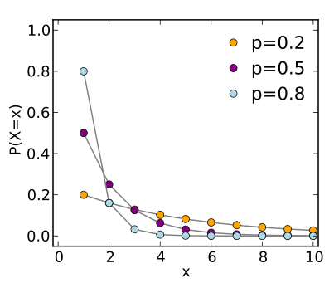
Geometric Distribution - Greater the probability, lesser number of trials (x) are needed for success.

Slide 24
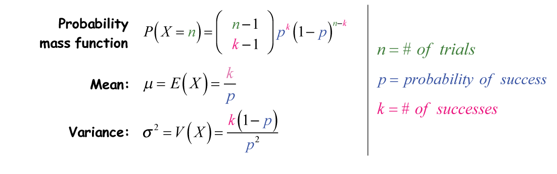
Bernoulli: Pascal’s Distribution (a.k.a Negative Binomial Distribution)
Binomial → In “n” trials, what is the probability of x successes ?
Geometic → How many trials needed for 1st success ?
Pascal’s → How many trials needed for “k” successes ?
No. of trials

Slide 25
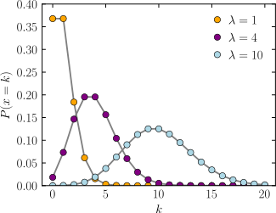
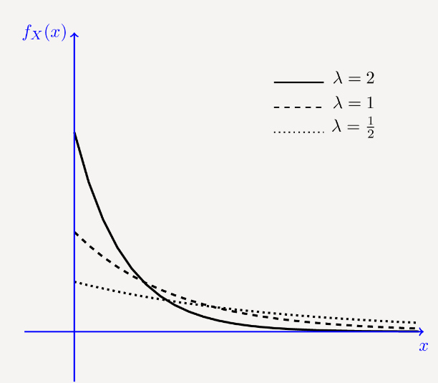
Other Distributions
Poisson’s distribution:
It gives the probability of an event happening a certain number of times (k) within a given interval of time or space. The Poisson distribution has only one parameter, λ (lambda), which is the mean number of events / time.
λ = 2 times/day solar-flare. In one hour, what is prob. of getting “x” solar flares?
The exponential distribution::
A continuous probability distribution that often concerns the amount of time until some specific event happens.
λ = 10 customers/min. Event = 1000 customers. How much time will it take to reach 1000 customers.

Slide 26

Normal Distribution
Most variables in nature follow normal distribution.
Height, weight, bp, speed of cars on road, profits, … …

Slide 27
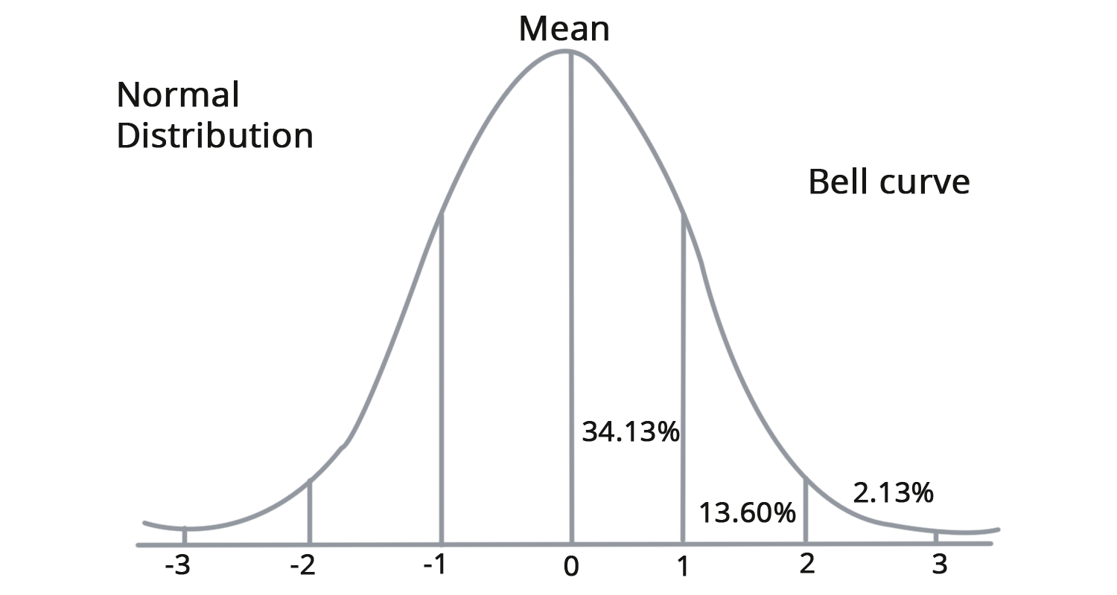

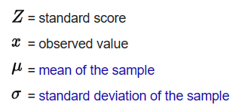
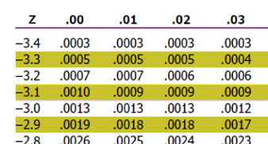
Z-Score for a particular “x” value
Z-score represents the CDF value
= prob. of that x happening.
x
Assume Z-score = -3.22
Look at z-table for row with -3.2 and for the 0.02 column
The entry for this gives the Probability of that z-score happening.
In this case … 0.0006 or 0.06%.
Z-score for some data item = -3.22
Probability of item being this far-off from mean = 0.06%

Slide 28
Hypothesis Testing

Slide 29
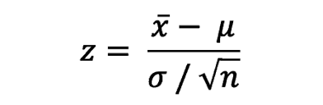




Z-Score for a sample mean (Standard Error)
Standard Error
x
u
Sample’s mean
Population mean
So we know that pop. u (i.e., the real mean) lies somewhere between these 2 values (for a specific z-score)
Bigger the “n”, the closer u is to x. That is, bigger samples give better estimates of u.

Slide 30
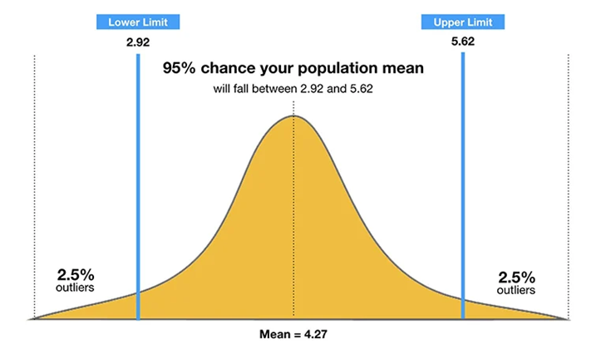
Z-score for 95% C.I. (two tail)
“Ha: Avg. weight of population is not 70 kgs” … This is example of 2-tail test. That is, we are saying the avg. wt. is >70 or <70. So outliers could lie on either side of the bell-curve.
Two tailed (i.e., a sample value could be less/more than pop. mean) and alpha = 0.05.
Alpha is the Outlier region. CI of 95% means alpha = 0.05 (i.e, 1 – 0.95)
Only 5% (0.05) values could lie in the outlying regions. That is 2.5% probability on left side and 2.5% on right side.
So we look in z-table for 0.025 or 0.975 probabilities. We get z-scores of -1.96 and +1.96
Z-score = -1.96
Z-score = +1.96

Slide 31
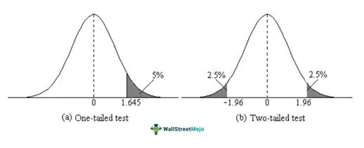
Z-score for 95% C.I. (one tail)
One tailed (i.e., a sample value is less than pop. mean) and alpha = 0.05.
Alpha is the Outlier region. CI of 95% means alpha = 0.05 (i.e, 1 – 0.95)
If we only consider values < pop. Mean, then entire 5% outliers are on the left tail.
If we only consider values > pop. Mean, then entire 5% outliers are on the right tail.
So we look in z-table for 0.05 or 0.95 probabilities. We get z-scores of -1.645 and +1.645
Z-score = +1.645

Slide 32

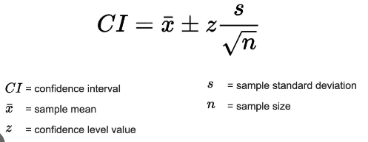
Example: Confidence Intervals
“Advertisement: Based on our sample, we are 95% confident that our medicine reduces cancer by 76%”. We tested with sample size = 25, std.dev = 2.
So what is the most likely value of mean (u) … with max error of only 5% ?
5% error means 95% C.I. or alpha = 0.05. For 2-tail interval, we use critical alpha values of 0.025 and 0.975.
From z-table, this gives z-scores of -1.96 and +1.96
75.22%
X=76%
76.78%
CI = 76 +/- 1.96 * 2 / sqrt(25)
= 76 +/- 0.78
= 75.22 …. 76.78
I am 95% confident that cancer is reduced within this interval.
Conf.Interval = 76 % +/- 0.78 %

Slide 33
Hypothesis Testing
“Advertisement: Our super-snack choco bar has 30 gms of protein … with std.dev of 2 gms”
Competitor: Hmmmm… We think you are misleading the public.
26
28
X = 30
32
34
Null and Alternative Hypothesis
Ho : u = 30 (currently accepted state)
Ha : u =/= 30 (the challenge to current state)
N=36
29

Slide 34
Hypothesis Testing
“Advertisement: Our super-snack choco bar has 30 gms of protein … with std.dev σ of 2 gms”
“Competitor: We took a sample (n=36) and its avg was only 29 gms. So you are lying !!”
Is this Competitor’s accusation correct ?
Competitor’s sample
Company’s claim
N=36
29
26
28
X = 30
32
34
Ho : u = 30
Ha : u =/= 30

Slide 35

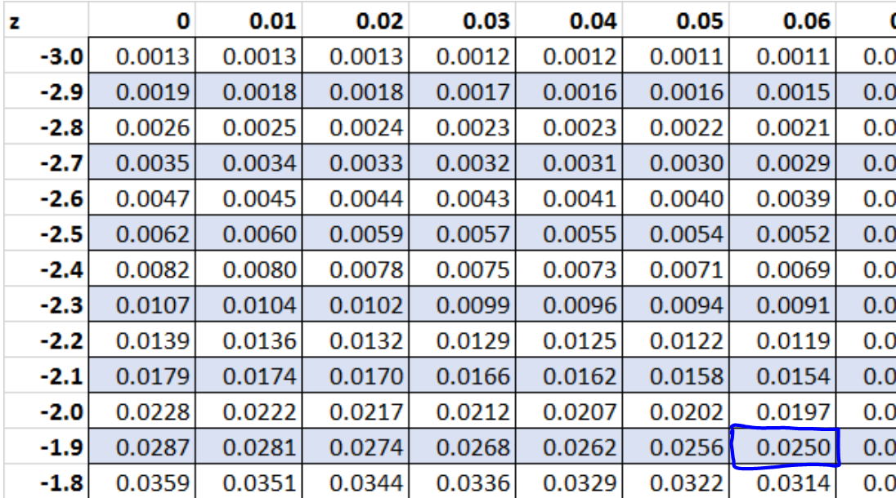
U = 30
X = 29
σ = 2
n = 36
Alpha = 0.05
Z-score statistic = 29 – 30 / 2/sqrt(36)
= -1 / (2/6) = -3
Z-Critical Values (2-tail):
alpha = 0.05. Critical values will be at prob. 0.025 & 0.975
z-critical values = -1.96 and +1.96
Ho : u = 30
Ha : u =/= 30
Rival company:
Our sample shows mean of 29 gms. Such a sample is nearly impossible ( -3 < -1.96).
This sample mean’s z-score lies below the cut off z-critical of -1.96 for 2.5% probability.
That is, there is less than a 5% chance we could have gotten such a different sample.
Only way, we could have got such a sample is if the real mean is NOT 30 gms.
Hence, our sample’s mean is significantly far-off and we reject Ho. Ha: mean =/= 30 is true.
Z-score for sample mean – within critical regions.
-3.0 -1.96 0 +1.96

Slide 36
Hypothesis Testing
What if the company claimed: Mean u = 30 gms with σ = 4 gms
Is the rival company still right ?
U = 30
X = 29
σ = 4
n = 36
Alpha = 0.05
Z-score statistic = 29 – 30 / 4/sqrt(36)
= -1 / (4/6) = -1.5
Z-Critical Values (2-tail):
alpha = 0.05. Critical values will be at prob. 0.025 & 0.975
z-critical values = -1.96 and +1.96
Rival company:
Our sample of 36 choco bars shows mean of 29 gms protein.
The mean (29gms) has a z-score of -1.5 which lies above cut-off z-critical of -1.96
So our sample’s mean is not significantly far-off from the claimed mean of 30.
So we have “failed to reject Ho”. We cannot reject the company’s claims just yet.
Z-score for sample mean – NOT IN critical regions.
-1.96 -1.5 0 +1.96

Slide 37
Steps in any hypothesis testing
Step 1: State the Hypotheses (Ho and Ha)
Step 2: Find the Critical Values (Zc … from the lookup table)
Step 3: Compute the Test Statistic
Step 4: Compare critical –vs- computed values. Make the Decision (reject Ho / accept Ha).

Slide 38
Practice 1: Looking up z-table
A random variable 𝑋 follows a normal distribution with 𝜇 = 6 and 𝜎 = 1.24. Calculate the following probabilities:
a) 𝑃(𝑋 ≤ 8)
Z = (8 – 6) / 1.24 = 1.61 === 0.9463
b) 𝑃(𝑋 ≤ 3)
Z = (3 – 6) / 1.24 = -2.41 === 0.0080
c) 𝑃(𝑋 ≥ 7)
Z = (7 - 6)/1.24 = 0.806 === 0.790
P (X > 7) = 1 – 0.790 = 0.21
d) 𝑃(7 ≤ 𝑋 ≤ 10)
P(X < 10) = (10-6) / 1.24 = 3.22 === 0.9994
P(X < 7) = 0.790
P(7 < x < 10) == 0.9994 – 0.790 = 0.209
3 4 5 6 7 8 9 10

Slide 39
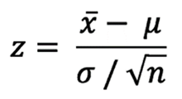
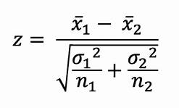
Z-Test (2 sample test)
One sample test: Compare sample to population
Compare means of 2 different samples from 2 different populations.

Slide 40
T-Statistic
Hypothesis Testing

Slide 41
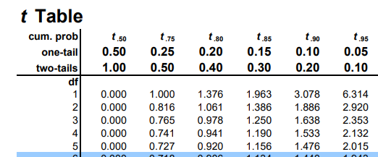
Student’s T-Distribution
We want to estimate something about population with a certain confidence level. ... But ....
1. We don't have population std.dev (σ) but only have sample std.dev. (s)
2. sample size n < 30
To look up t-table, we need 2 things:
Df = degrees of freedom = n -1
Alpha value.
Use Z-test / t-test ?
n>= 30 | n<30
- - - - - - -| - - - - - - |- - - - - - -
σ known | Z-test | Z-test
- - - - - - -| - - - - - - | - - - - - -
σ UnKnown | Z/T-test | t-test

Slide 42
Example of T-Statistic (one sample)
Population u = 6 𝜎 = ??
Sample n = 15, x = 5.7, s = 1.5
Ho :: mean = 6 Ha :: mean =/= 6
T-Statistic
T = (x - u) / (s / √n)
T = (5.7 – 6) / (1.5 sqrt(15) ) = - 0.775
T-critical lookup
Alpha = 0.05
Df = n-1 = 14
= 2.145 and -2.145
Comparison: critical t-value (-2.145) < computed t-statistic (-0.775) <<
So fail to reject Ho. That is.. We accept Ho: Mean == 6
-2.14 -.775 +2.14

Slide 43
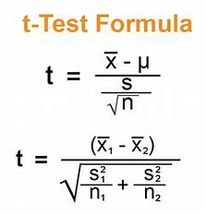
T-Statistics
One sample test
Two Sample test

Slide 44
Sample Size Estimation

Slide 45

Sample Size Estimation based on margin of error.
I want you to tell me the average age of the people in this city with a 95% confidence interval and a +/- margin of 2 years.
What is n ?
Error =
We take a sample and we get std dev = 5 and mean of 40 yrs.
N = (1.96 * 5 / 2)^2 ~= 25
Z^2 . σ^2
n = --------------
E^2

Slide 46
Sample Proportions

Slide 47
Comparing Sample proportion vs Population proportion
A population proportion is a fraction of the population that has a certain characteristic.
For example, a city Census showed that 83.7% of the population was identified as being French; the value of 0.837 is a population proportion.
Problem Statement: Is the population proportion still the same as before ?
P --> Population Proportion
P" -> Sample proportion
Ho = u Ha =/= u
The underlying distribution is binomial ... but as n.p > 5 and n(1-p) > 5, the distribution begins to look more like a normal distribution and C.L.T applies. Hence, we can compute the Z-score as:
Z-score = (P" - P) / √ (pq / n)
where σ for binomial dist: √ p.q = √ p.(1-p)

Slide 48

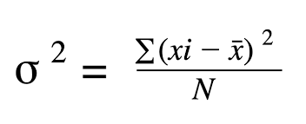
F-Tests
Test if 2 Normally distributed populations have the same variance.
Named in honor of Ronald Fisher.
Can think of it as a comparison of 2 samples for similar variances.
F = Larger variance-1 / smaller variance-2
Assumption:
- Normal distribution
- Random & independent samples.
But we can also use the ratio concept for many other tests:
- test overall significance of regression model.
- Compare fits of different models.
- Test equality of means.
So F-test is considered a very flexible broad test for comparing different parameters.

Slide 49
ANOVA
One way Anova

Slide 50
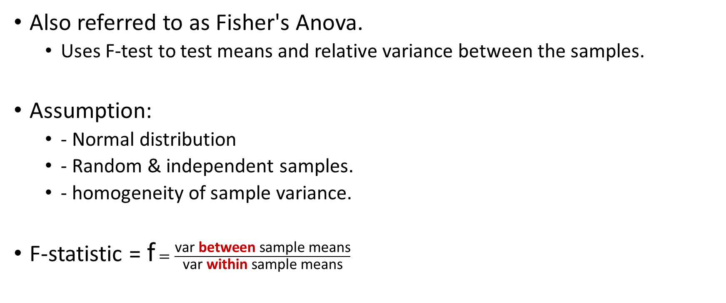
Anova
Also referred to as Fisher's Anova.
Uses F-test to test means and relative variance between the samples.
Assumption:
- Normal distribution
- Random & independent samples.
- homogeneity of sample variance.
F-statistic = f $=\frac{\text{var} \text{between} \text{sample} \text{means}}{\text{var} \text{within} \text{sample} \text{means}}$

Slide 51
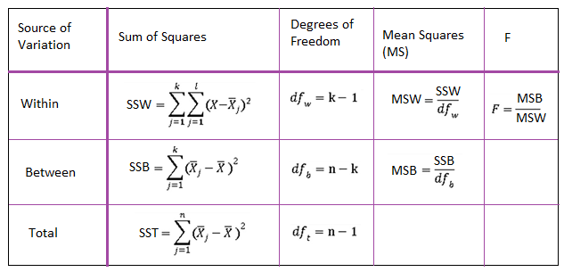
Summary of Anova Computation

Slide 52
Where would you use this in data science ?
Independent variables Xi are categorical and dependent variable (target) is numeric:
eg
Loc Company MF Salary (Y)
BLR IBM M 2000
MAA Nokia F 2200
BLR Samsung M 3700
BOM Juniper M 4200
. … . . .
Regression Model: Y = B0 + B1.x1 + B2.x2 + …
If we want to see if Location has any impact on salary, and if this should be included in our model.
Sp Loc can be re-written as:
BLR …. { 2000, 3700, 4000, 2400, ….. }
MAA … { 2200, 2500, 5600, 6700, 2300 …. }
BOM … { 5000, 6000, 8000, 5700 . . . }
Anova F-score would indicate if this feature (Loc) is worth including in our model or not. That is, Anova is used in feature selection.

Slide 53
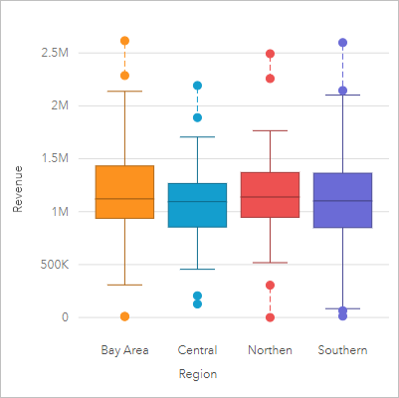
Alternative visual representation of Anova groups.
In the plot below, there is not much difference between the groups. So this feature would NOT be worth including in our regression model.
Not much difference between the groups.
LOW F-Score

Slide 54
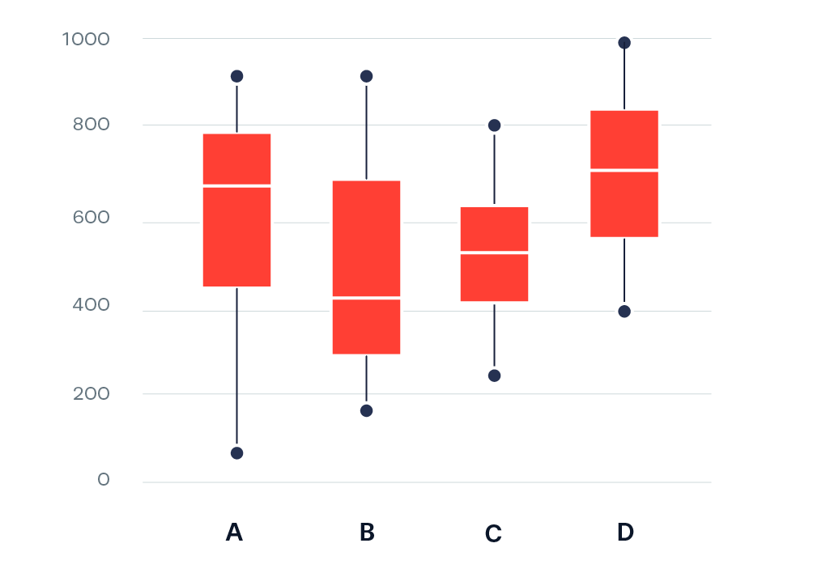
Alternative visual representation of Anova groups.
In the plot below, there is significant differences between the groups.
Significant difference between the groups.
HIGH F-Score

Slide 55
Example
Groups Mean
G1 = [1,3,5] X1 = 3
G2 = [5,7,9] X2 = 7
G3 = [4,5,6] X3 = 5
Global mean also ... Xg = 5
Sum of Squares within Groups: SSW
SUM( Xi - X1 )^2 of Group 1
SUM( Xi - X2 )^2 of Group 2 . . .
SSW
= Sum of all the above
= (4+0+4) + (4+0+4) +(1+0+1) = 18
SSB
Sum of Squares Between Groups :
SSB = N1 * SUM( X1 - Xg )^2
= 3*(3-5)^2 + 3(7-5)^2 + 3(5-5)^2
= 3*4 + 3*4 + 3*0
= 24

Slide 56
Example
F-statistic = MSB / MSW
MSB = SSB / dof
MSW = SSW / dof
c = # of categories. = 3
n = # of all observations = 9
F = SSB / (c-1) --> dof = # of categ. - 1
----------------
SSW / (n-c) --> dof = # of obs - # of categ.
If all groups have same means & variance ... F = 0. p-value = 1
If groups different, then F gets bigger and p-value gets smaller.
F = (24 / 2) / (18 / 6)
= 12 / 3 = 4.0

Slide 57
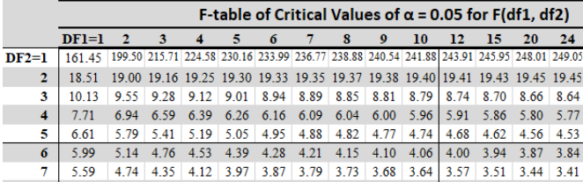
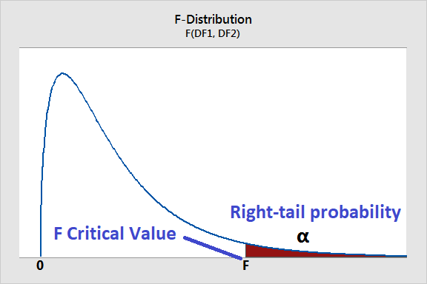
Is the F-Score significant.
Now compare the F-statistic with F-critical value in F-table.
df(BG) => Find column = 2
df(WG)=> Find row. = 6
In this example, F-critical value = 5.14
Our F-compute (4.0) < F-Critical (5.14).
Hence, cannot reject Ho.
Ho : All groups are the same.
Conclusion: All groups have very little variation. Hence, including this feature (which contains these groups) in meaningless in our model.

Slide 58
Pearson Correlation

Slide 60
Non-Parametric

Slide 62
Spearman Correlation

Slide 64
Chi Squared

Slide 65
Mann-Whitney U-Test
Non-Parametric counterpart to T-Test (2 Groups)

Slide 66
Kruskal-Wallis H-Test
Non-Parametric counterpart to Anova (3 or more groups)

Slide 68
Parametric vs Non-Parametric Tests
Property | Param | Non-Param
Assumptions
Central Tendency Value
Correlation
. . . .

Slide 70
Linear Regression

Slide 72
Linear Relationship
y
Yp = B0 + B1.x1 + e
x1

Slide 73
Normality
Not Var v
y
Var v
Var v
Var v
Independence of data points
x

Slide 74
Homoscedasticity
y
Yp - Yi
x
x

Slide 75
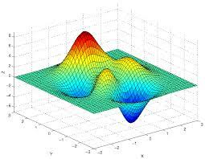
MultiVariate
Yp = B0 + B1.x1 + B2.x2 + e
Price ~ sq.ft.area and age.of.house
x2
y
x1

Slide 77
Population Regression Equation
y
x

